Slide 1


IN ASSOCIATION WITH

Slide 2
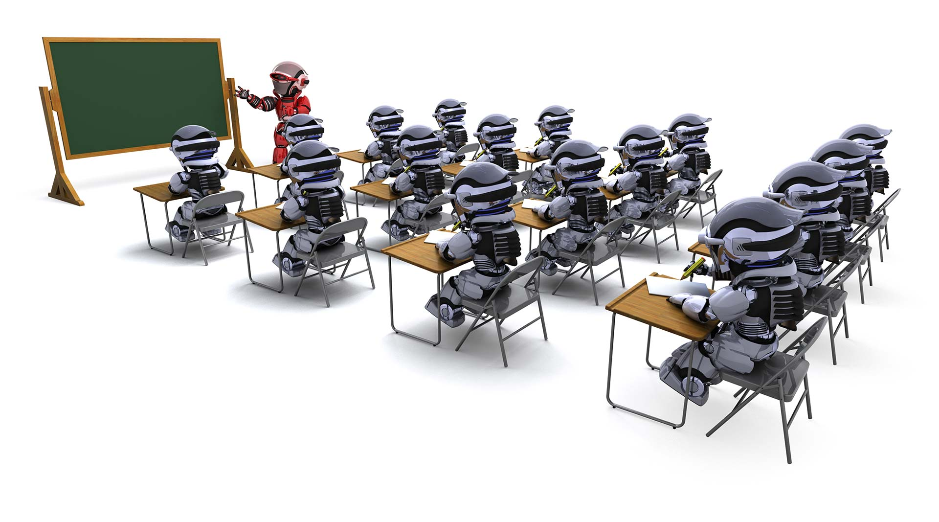
ROBOTICS WORKSHOP

Slide 3
INTRODUCTION
WHAT IS ROBOTICS ???????
ROBOTICS FOR SCHOOL STUDENTS
WORKSHOPS
Certificate Distribution

Slide 4
INTRODUCTION
This workshop will provide students a base to ROBOTICS.
They will learn to control the robots using normal electrical concepts.
The workshop focuses on application and use of technology .
The duration of this workshop will be 2-3 consecutive days

Slide 5
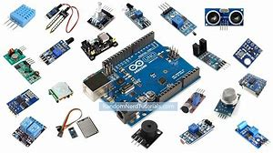
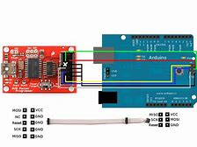
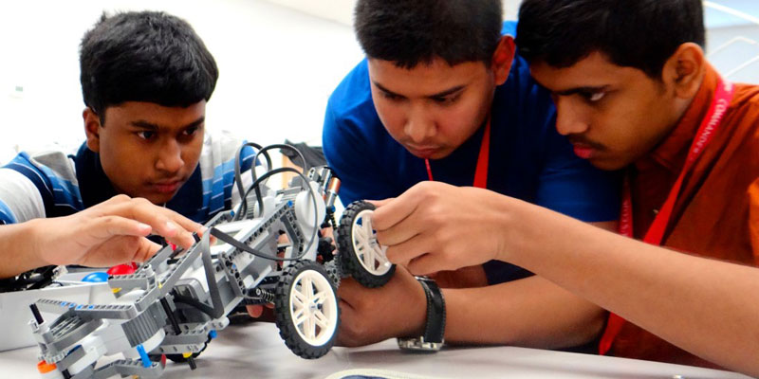
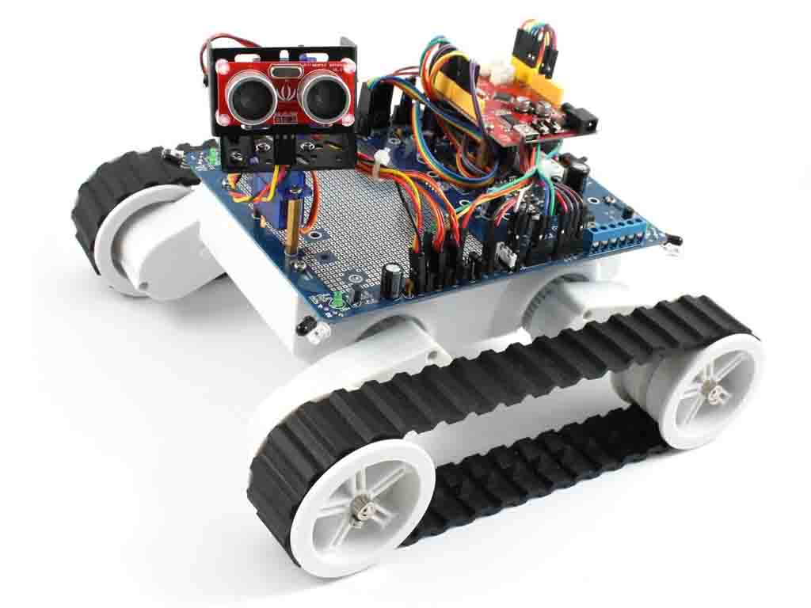
WHAT IS ROBOTICS……???????

Slide 6
Robotics is an interdisciplinary branch of engineering and science that includes mechanical engineering, electrical engineering, computer science, and others.
The concept of creating machines that can operate autonomously.

Slide 7
ROBOTICS FOR SCHOOL STUDENTS
Student Robotics is a volunteer based program.
Consists of programming concepts.
For global representation of schools/colleges.
Enhances creativity and it kind of school extra curriculum activities.

Slide 8
WORKSHOPS
It’s a special Program Designed for young Minds.
Students will be given special training to interface hardware's and software's.
Learning about sensors and basic hardware's.
Introduction to software's and hardware's.
Basic programming skills
Basic hardware installations.
Assembling sensors with programs and software's.
Working on Real Time Based Projects.

Slide 9
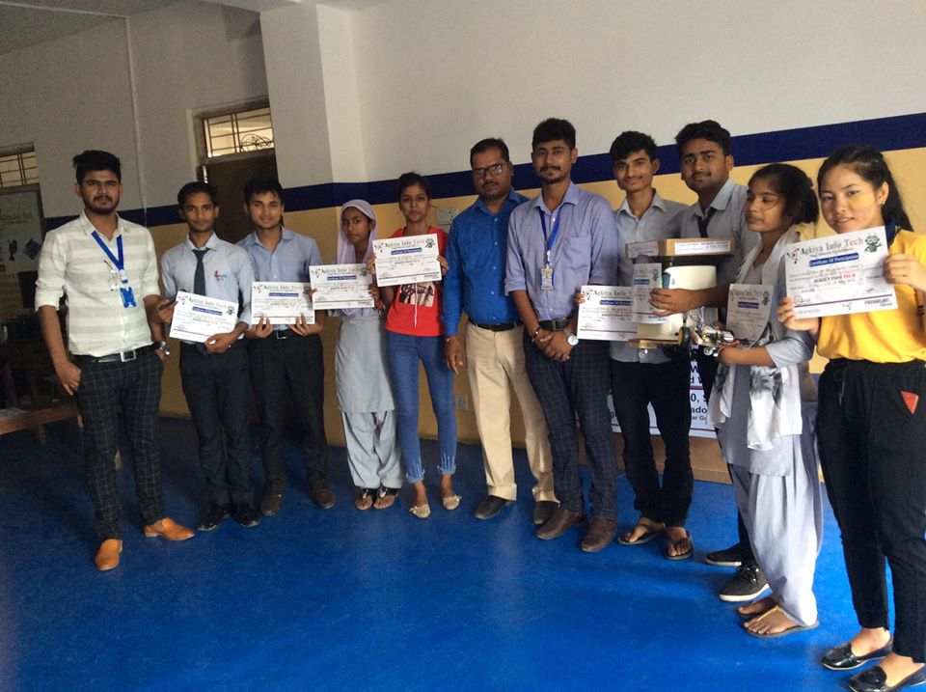
GALLERY

Slide 10
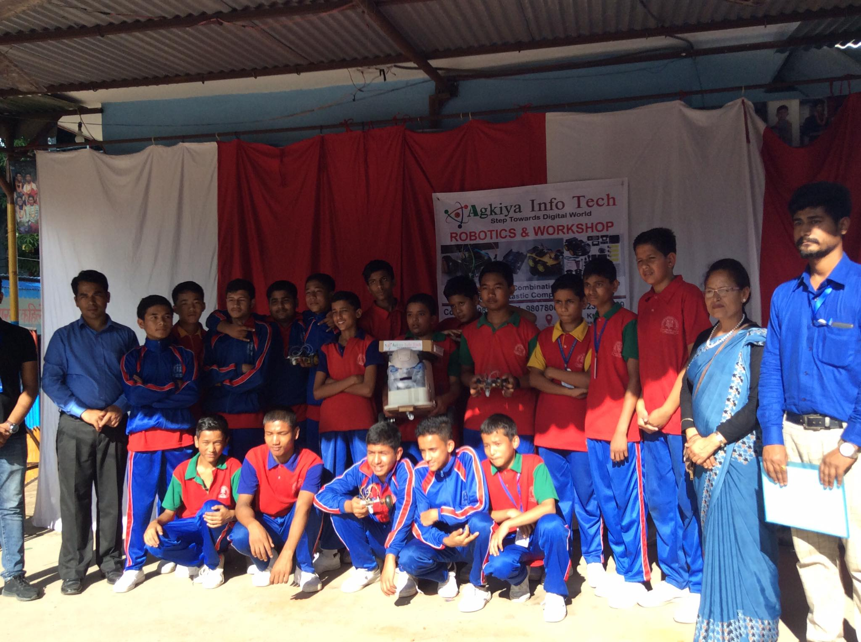

Slide 11
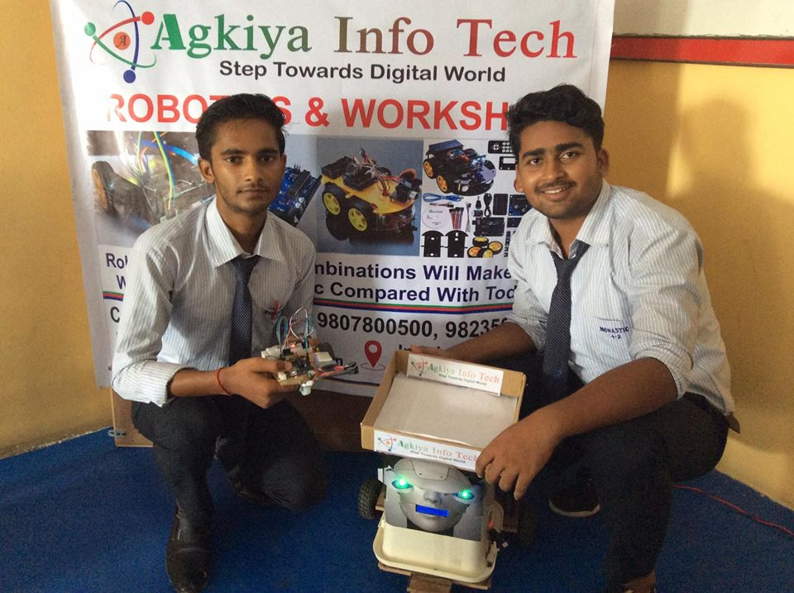

Slide 12
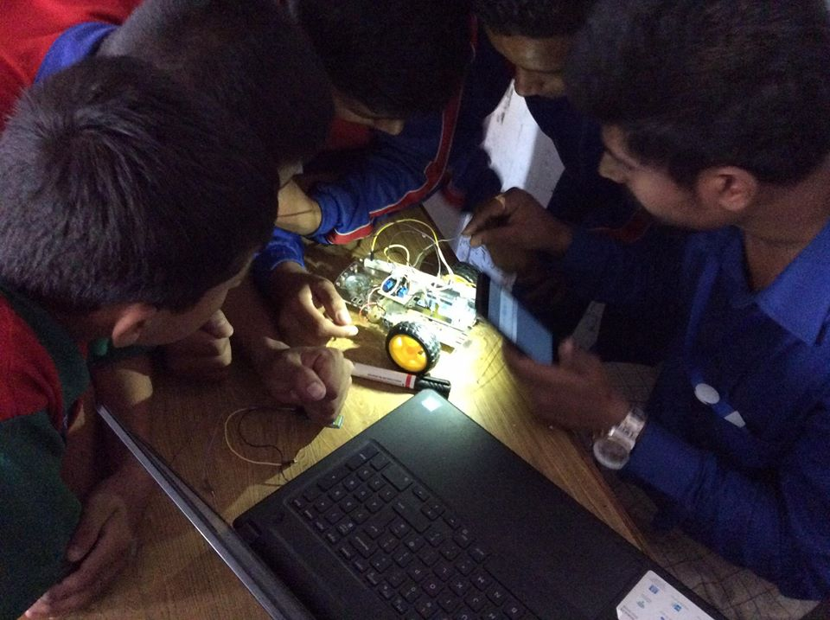

Slide 13
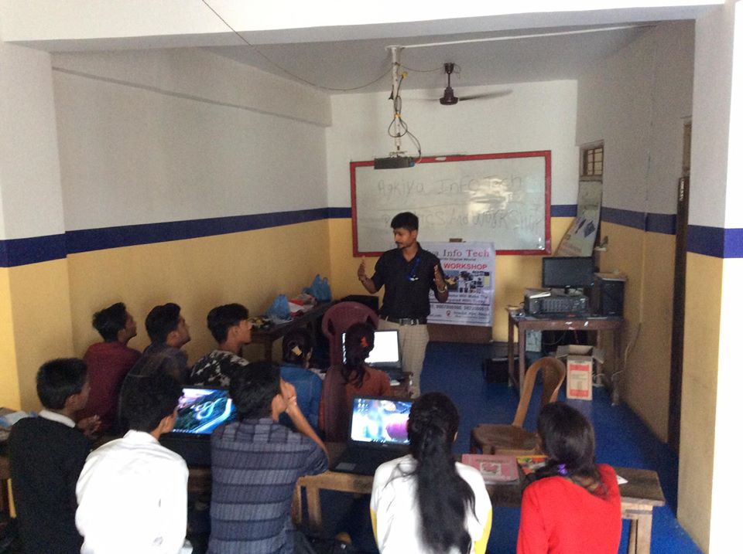

Slide 14
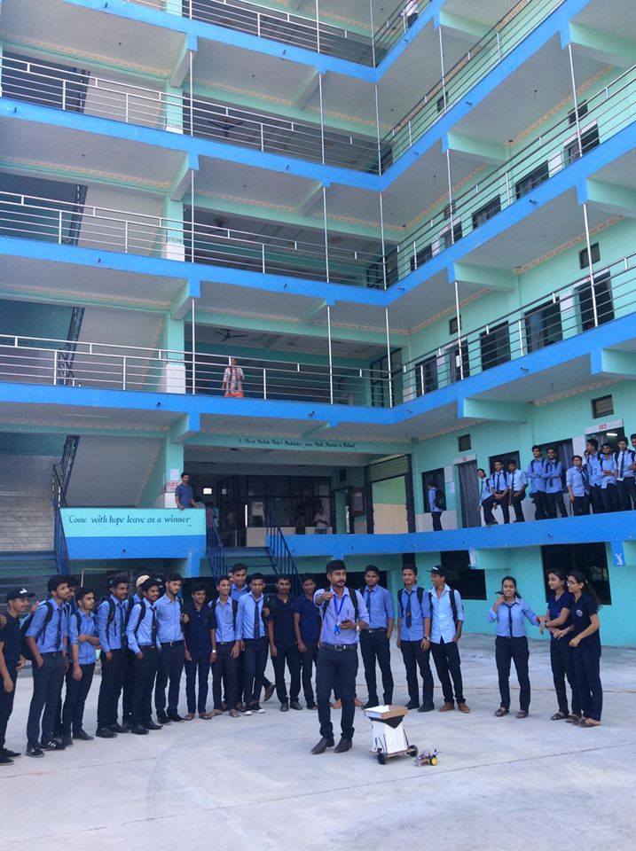

Slide 15
Thank you

